Slide 1
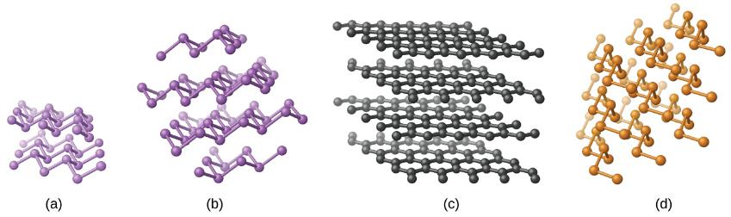
The Solid State:
A Particulate View
(OpenStax 10.5-10.6 Gil. 18)

Slide 2
Spring 2020 Online
This section is about different types of solids especially metals.
Please watch the Metal Video From Nova on Pilot. There will be a worksheet on pilot in the form of an ungraded quiz.
There are not advanced videos for these slides. The Live Class Collaborative meeting MWF at 12:15 will be recorded going over these slides. Communicate> Collaborative Ultra
Menu in the upper left of the bar > recordings.

Slide 3
Discussion: Molecular Orbital Theory
Think about your responses to the following questions:
What are molecular orbitals?
How do they compare with atomic orbitals?
What do you know about the energetics of molecular orbitals, especially as compared to atomic orbitals?

Slide 4
Classification of Solids
Crystalline Solids: Solids made of an ordered array of atoms, ions, or molecules
Positions of components are represented by lattice(s)
A three-dimensional system of points that designates the position of the components of a substance
The smallest repeating unit is termed a unit cell
Amorphous Solids: Noncrystalline, disordered array of atoms, ions, or particles in a solid state (e.g., glass)
Notes:
(9.3) An introduction to structures and types of solids

Slide 5
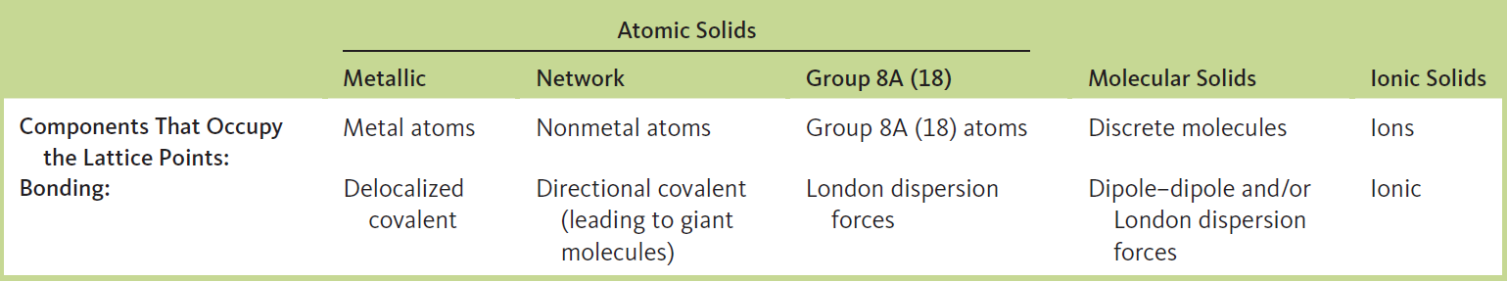
Types of Crystalline Solids
Ionic solid: possesses ions at the points of the lattice that describe their structures
Molecular solid: discrete covalently bonded molecules at each lattice point(s)
Atomic solid: atoms at the lattice points that describe its structure (e.g. metallic solids, network solids, or group 8A (18) solids)
Notes:
(9.3) An introduction to structures and types of solids

Slide 6
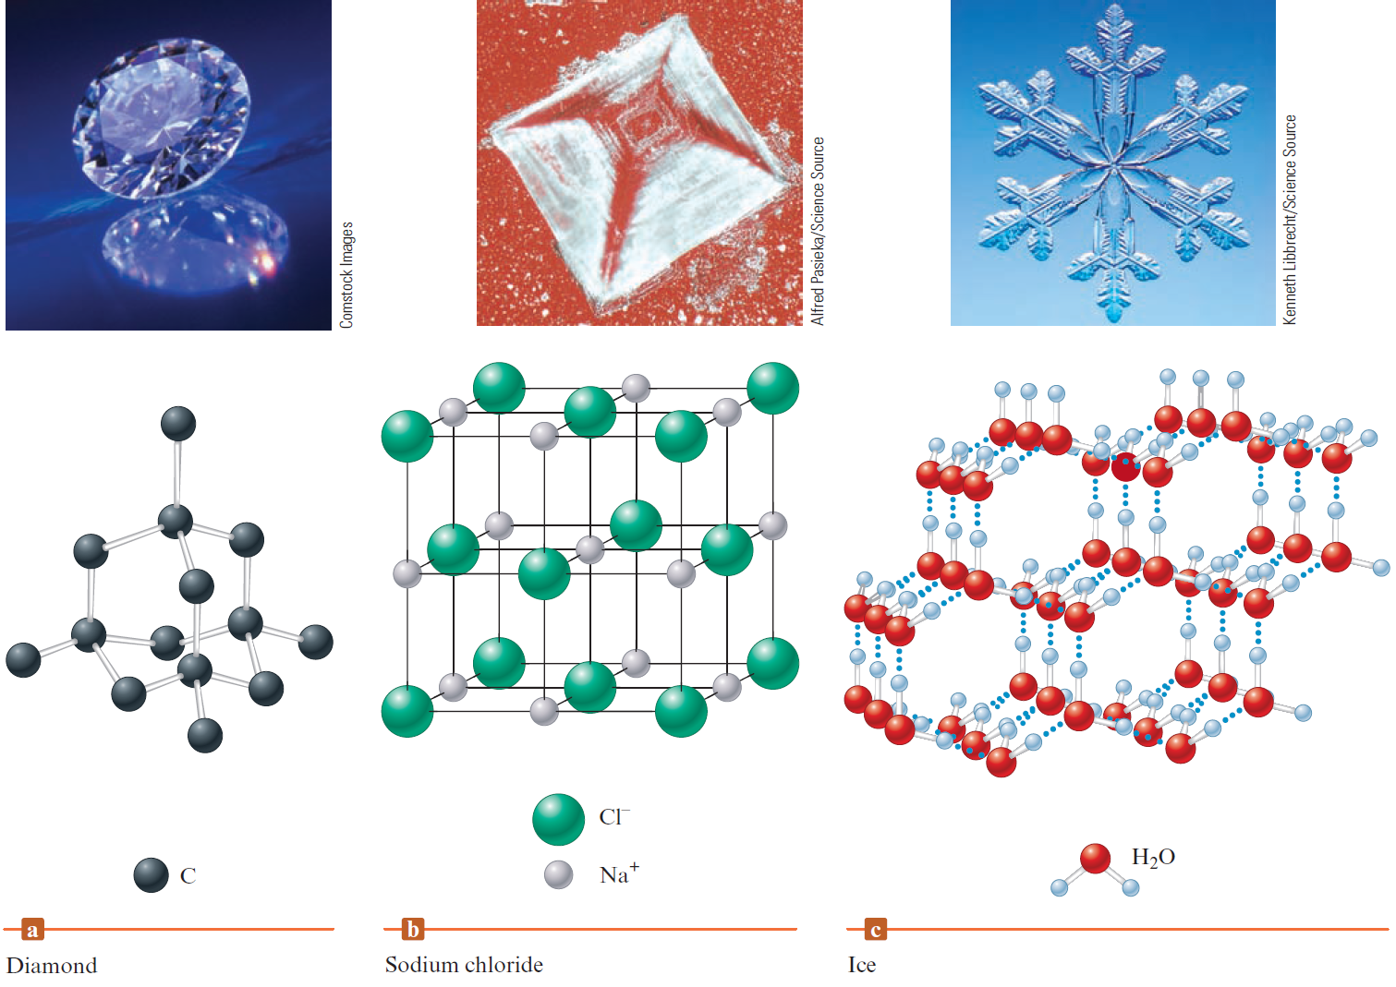
Types of Crystalline Solids
An atomic solid (b) An ionic solid (c) A molecular solid
Notes:
(9.3) An introduction to structures and types of solids

Slide 7
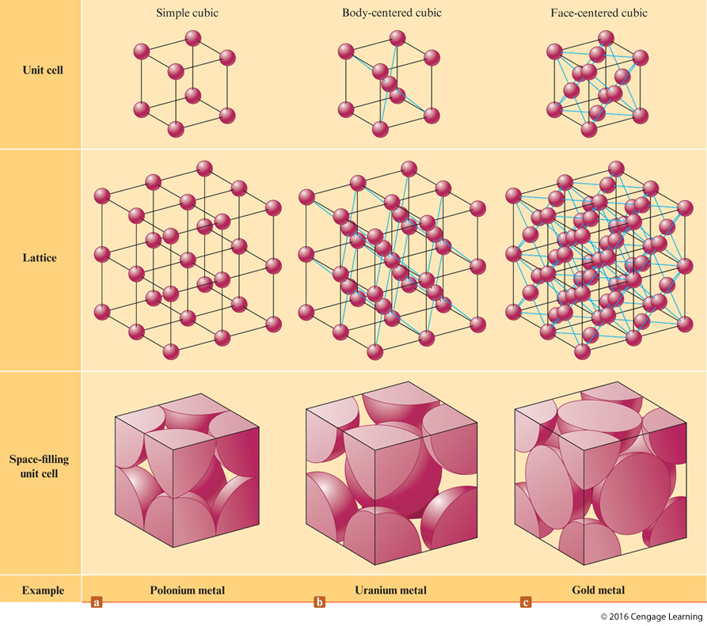
Atom Packing in the Solid State

Slide 8
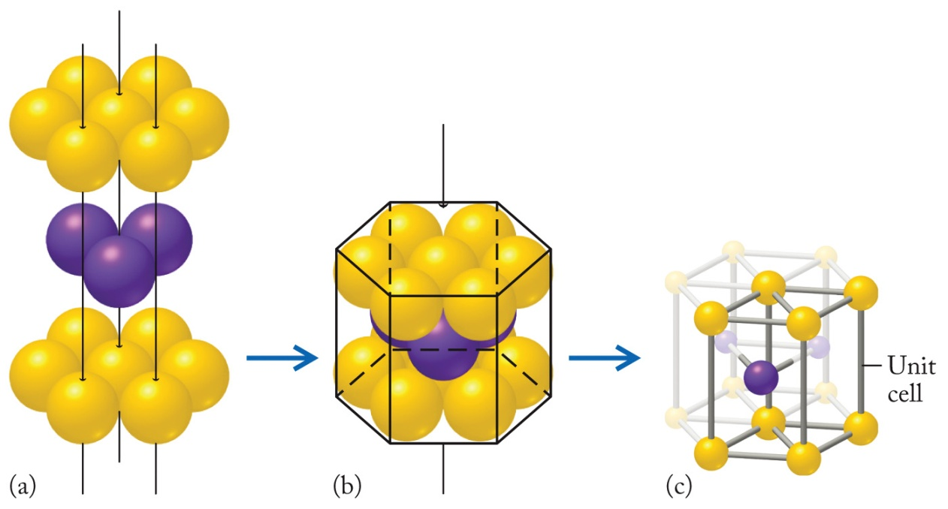
Stacking Patterns and Unit Cells
Unit cell: the basic repeating unit of the arrangement of atoms, ions, or molecules in a crystalline solid
Hexagonal unit cell: an array of nine closest-packed particles that are the repeating unit in a hexagonal closest-packed crystal
Face-centered cubic (fcc) unit cell: An array of closest-packed particles that has eight of the particles at the corners of a cube and six of them at the centers of each face of the cube.
Simple cubic (sc) unit cell: a cell with atoms only at the eight corners of a cube
Body-centered cubic (bcc) unit cell: cells with atoms at the eight corners of a cube and at center of the cell
Notes:
Stacking patterns determine the shapes of the crystals that metals form. Look at a cluster of atoms in the ababab… stacking pattern (Figure 18.3). This cluster forms a hexagonal (six-sided) prism of closely packed atoms. They are as tightly packed as they can be, the crystal structure is called hexagonal closest-packed (hcp). In these lattices, the nine-atom cluster serves as an atomic-scale building block.
Figure 18.3

Slide 9
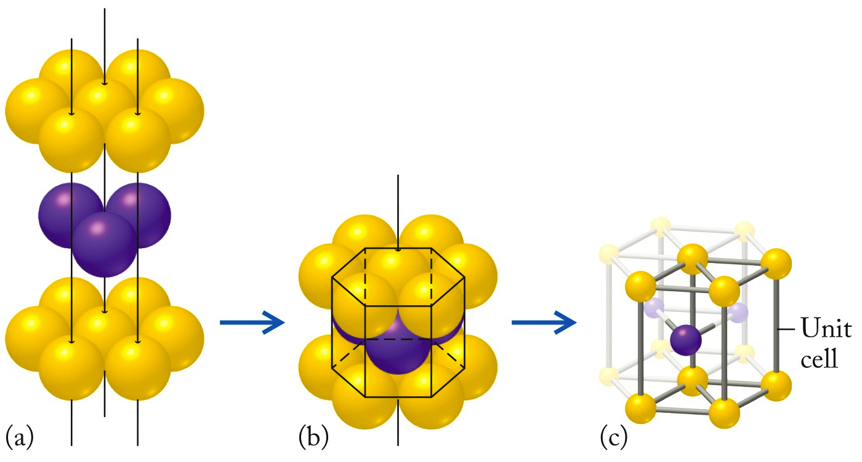
Unit Cells: Hexagonal
Hexagonal Unit Cell: Repeating unit in hcp consisting of an array of 9 closest-packed particles
Purdue Website on unit Cells for other views

Slide 10
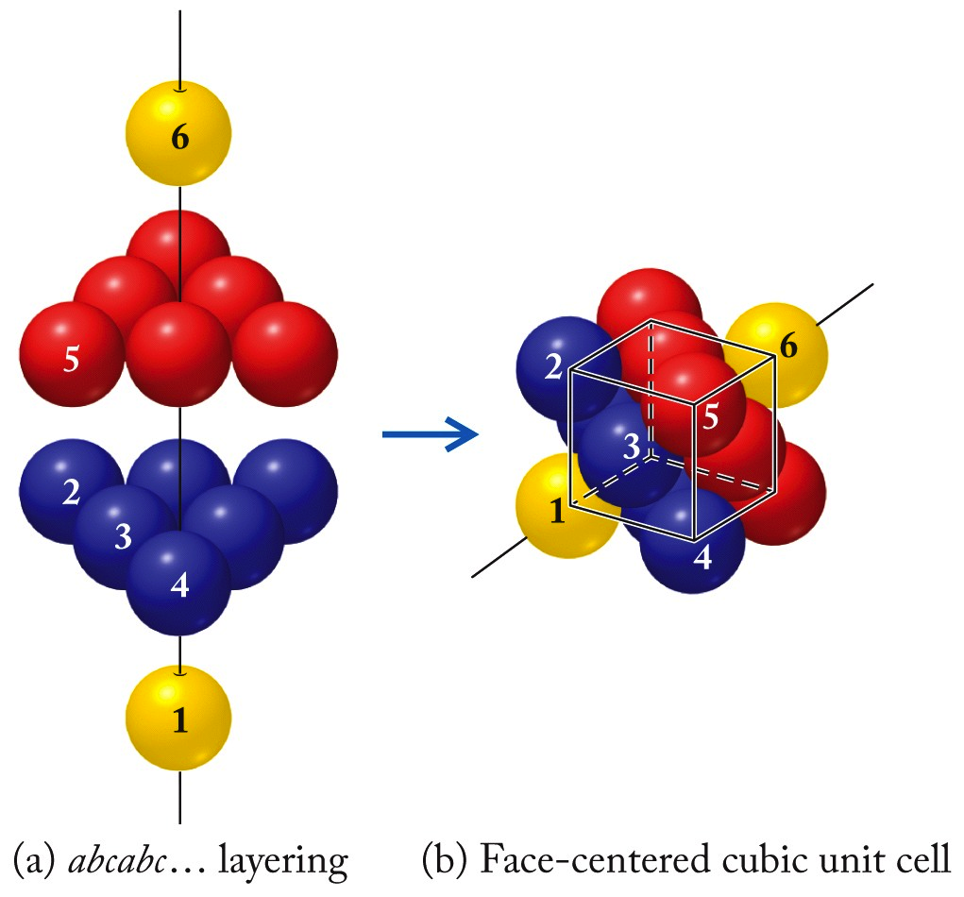
Unit Cells: Cubic
Face-Centered Cubic (fcc) Unit Cell: closest packing unit cell in which atoms are located on the 8 corners and 6 faces of a cube

Slide 11
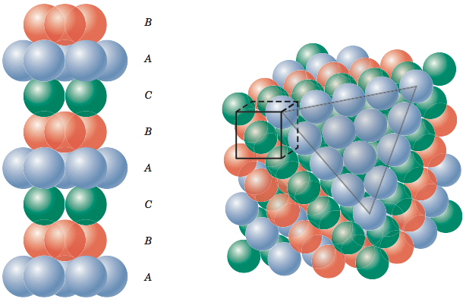
Cubic Unit Cells (fcc different view)
Face-Centered Cubic (fcc) Unit Cell: closest packing unit cell in which atoms are located on the 8 corners and 6 faces of a cube
https://www.e-education.psu.edu/matse81/node/2133
Notes:
This slide shows colors to indicate layers and unit cell

Slide 12
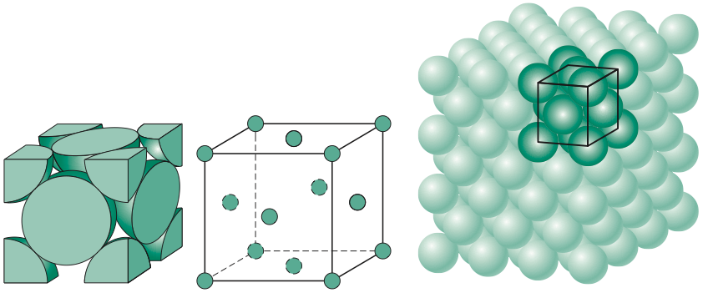
Cubic Unit Cells (fcc different view)
Face-Centered Cubic (fcc) Unit Cell: closest packing unit cell in which atoms are located on the 8 corners and 6 faces of a cube
https://www.e-education.psu.edu/matse81/node/2133
Notes:
This slide more easiliy shows dense packing of unit cell.

Slide 13
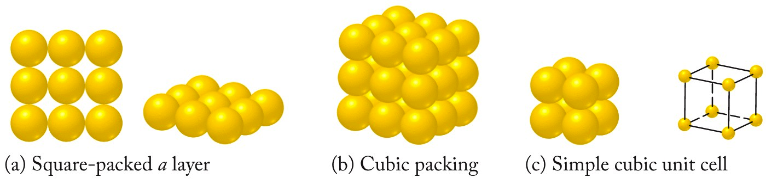
Unit Cells: Cubic
Simple cubic (sc) Unit Cell: Square-packing arrangement; particles located at 8 corners of cubic unit cell

Slide 14
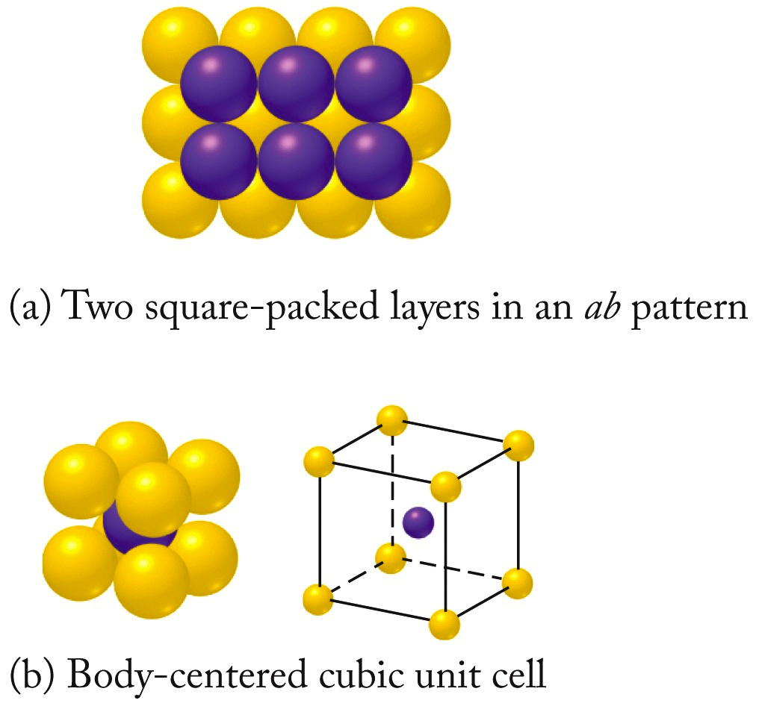
Unit Cells: Cubic
Body-Centered cubic (bcc) Unit Cell: Square packing arrangement in which particles are located at 8 corners and in center of cubic unit cell

Slide 15
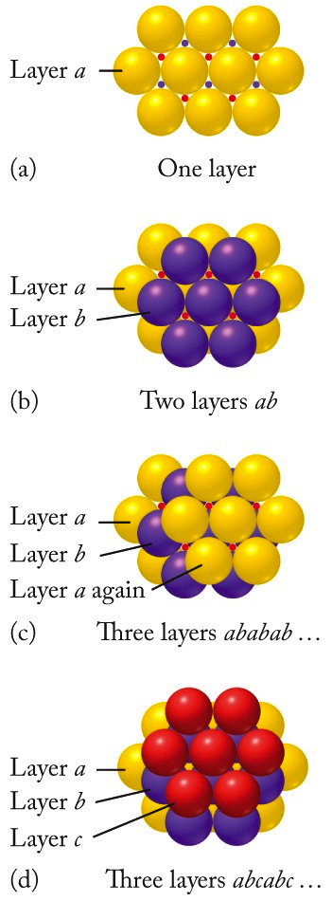
The Closest Packing Model
Closest packing (cp): an arrangement that assumes that metal atoms are hard, uniform spheres
Spheres are packed in layers
Each successive layer formed when spheres occupy a dimple formed by the spheres of the previous layer
Forms of closest packing:
aba packing
abc packing
Hexagonal Closest-Packing (hcp)
Three Layers
Two Layers
One Layer
Cubic Closest-Packing (ccp)
Notes:
(9.4) Structure and bonding in metals

Slide 16
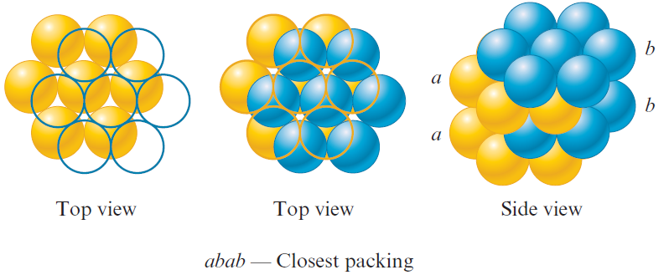
aba Packing
Second layer is like first, but displaced such that each sphere in the second layer occupies a dimple in the first layer
Spheres in the third layer occupy dimples in the second layer and lie directly over those in the first layer
Notes:
(9.4) Structure and bonding in metals

Slide 17
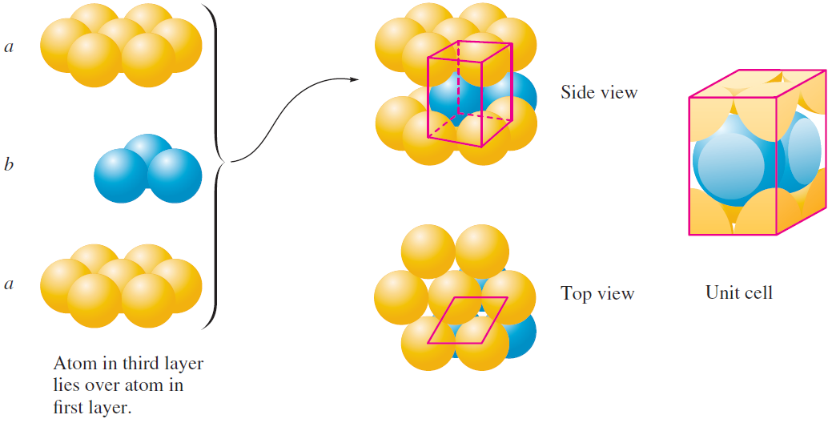
Hexagonal Closest-Packing (hcp)
Hexagonal closest packed (hcp) structures
Spheres in every other layer occupy same vertical position
When spheres are aba closest packed, the unit cell is a hexagonal prism
Notes:
(9.4) Structure and bonding in metals

Slide 18
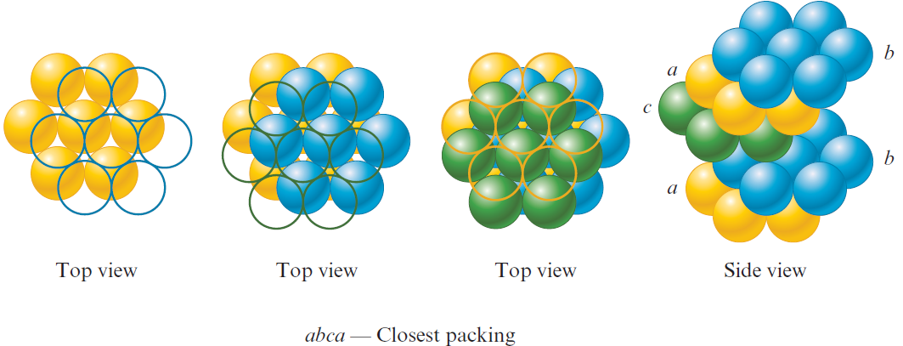
abc Packing
Spheres in the third layer occupy dimples in the second layer
Spheres in the third layer do not rest above spheres in the first layer
Fourth layer is like the first layer
Notes:
(9.4) Structure and bonding in metals

Slide 19
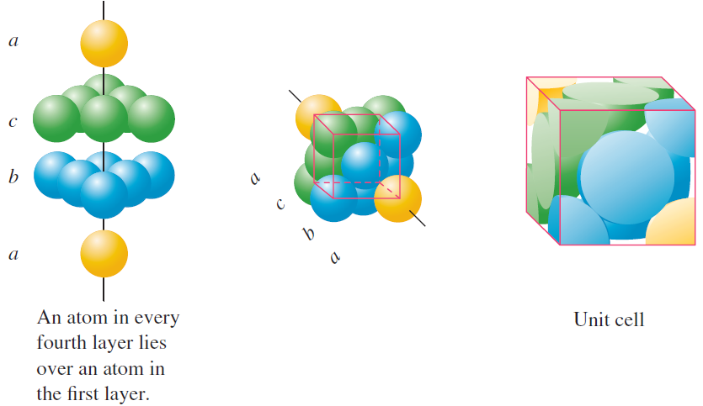
Cubic Closest-Packing (ccp)
Cubic closest packed (ccp) structure
Spheres in every fourth layer occupy the same vertical position
In abc packing, unit cell is face-centered cubic
Notes:
(9.4) Structure and bonding in metals

Slide 20
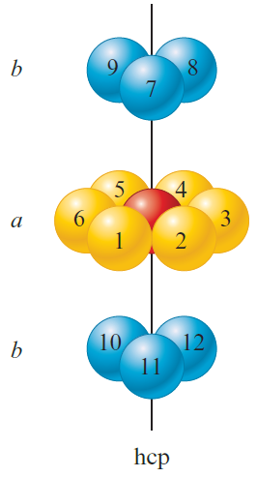
Common Characteristics of hcp & ccp Structures
Each sphere in both structures possesses 12 equivalent nearest neighbors
Notes:
(9.4) Structure and bonding in metals

Slide 21
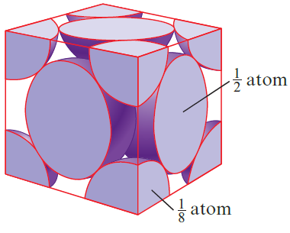
Unit Cell: Atom Counting
A unit cell is defined by the centers of the spheres on the corners of the cube
Net number of spheres in a face-centered cubic unit would be
Notes:
(9.4) Structure and bonding in metals

Slide 22
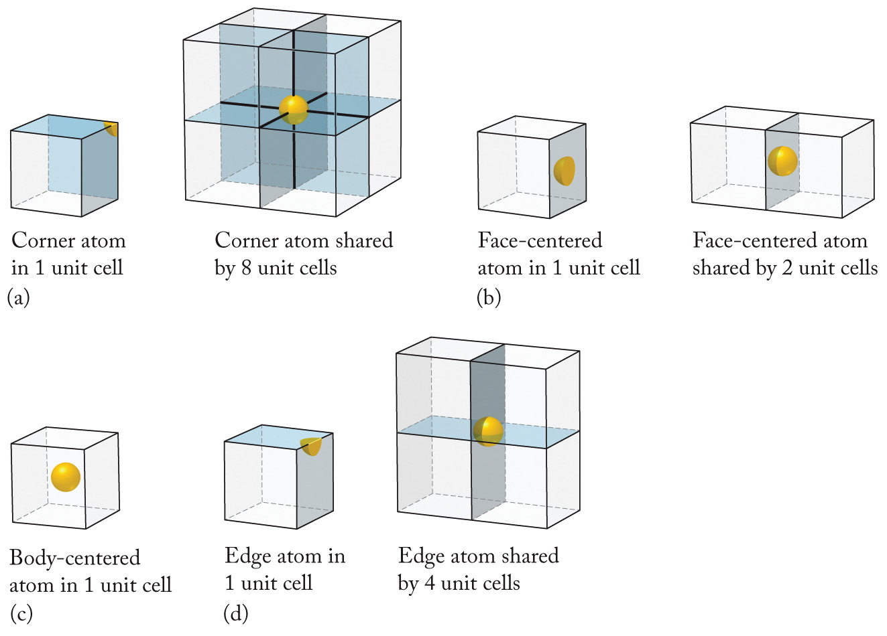
Unit Cell: Atom Counting
Notes:
Table 18.2 summarizes how atoms in different locations in sc, bcc, and fcc unit cells contribute to the total number of atoms and the relationship between r and l for the three cubic unit cells.
We noted that ccp and hcp are the most efficient packing schemes for spheres. The packing efficiency for fcc unit cell is 74.1%.
Figure 18.12

Slide 23
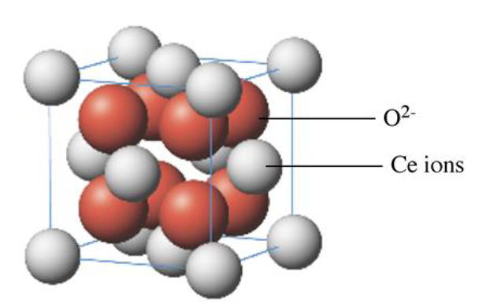
What is the formula of the oxide whose unit cell is shown?
Practice: Solid-State Chemistry
Ce₇O₄
CeO
Ce₂O₃
CeO₂

Slide 24
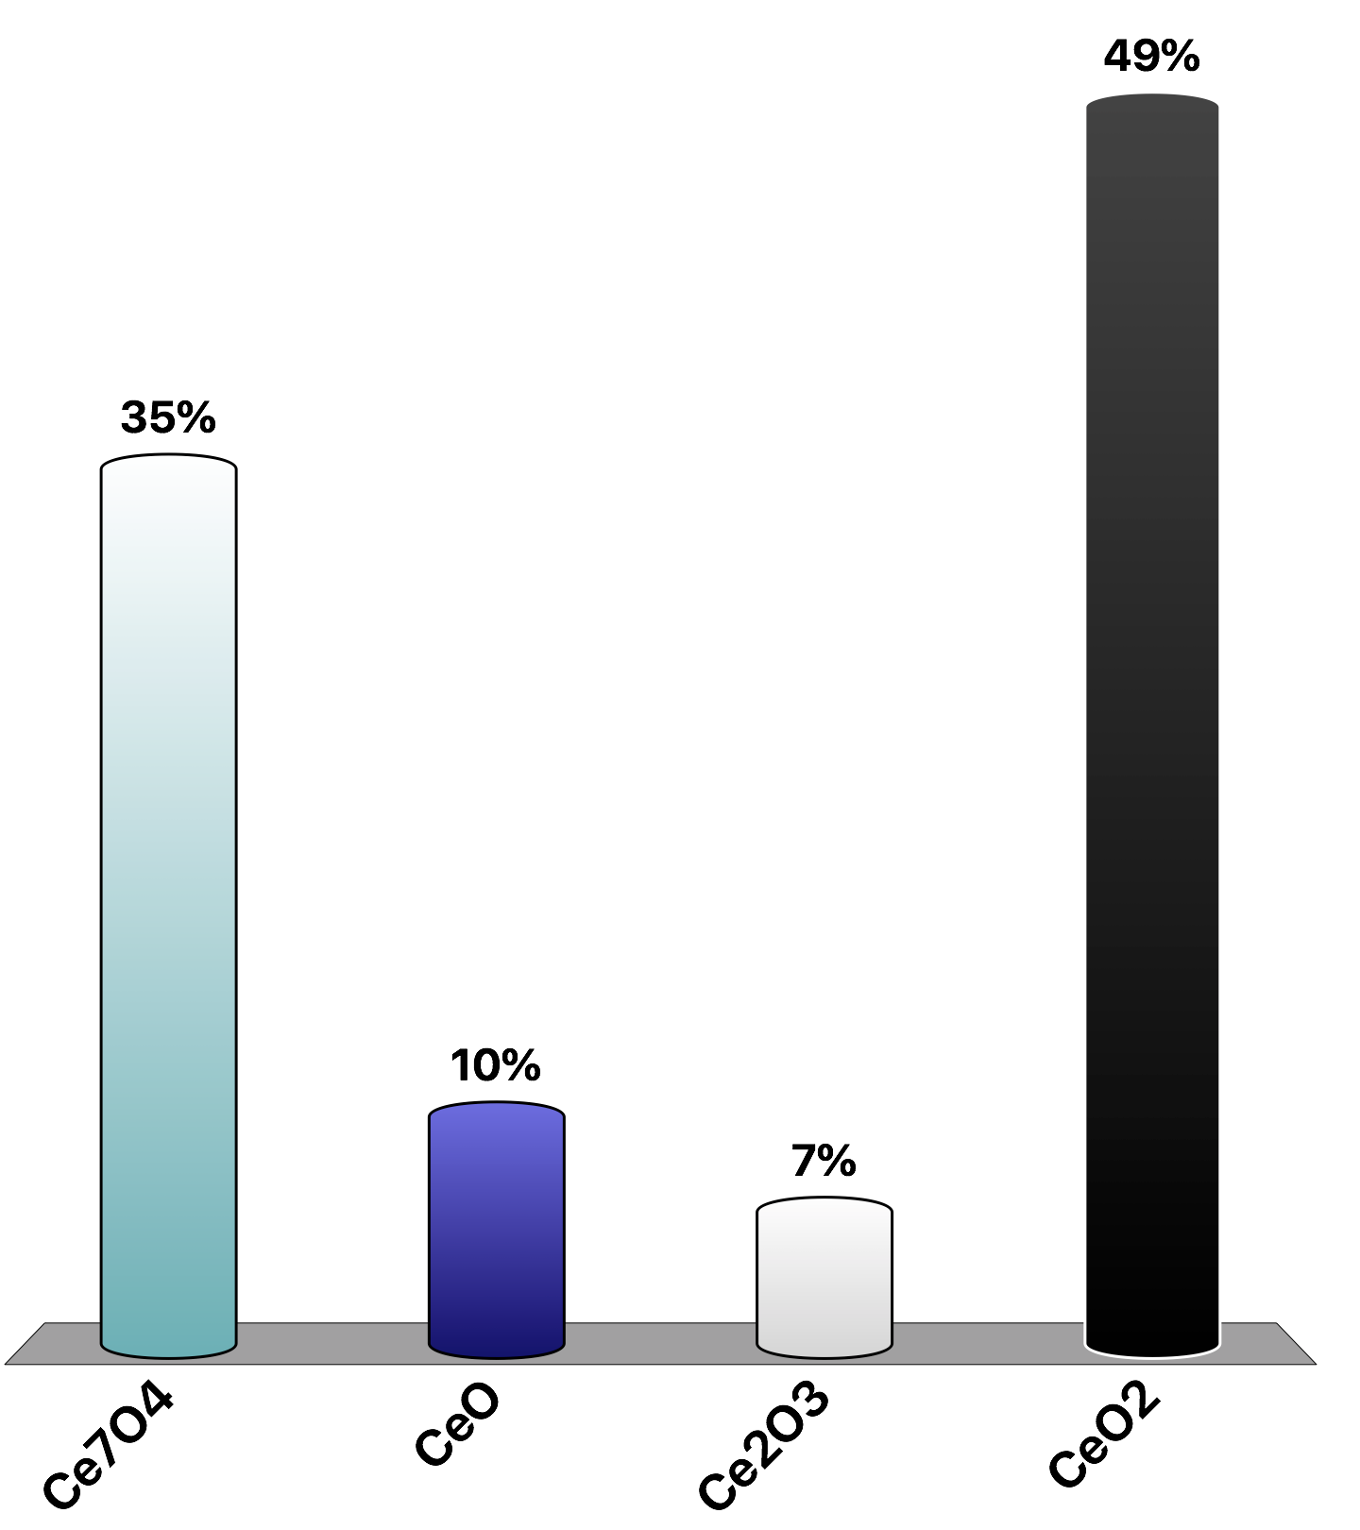
What is the formula of the oxide whose unit cell is shown?
Practice: Solid-State Chemistry
Need lowest whole number ratio:
CeO₂
Ce₇O₄
CeO
Ce₂O₃
CeO₂
For Ce:
8 at corners = 8 × 1/8 = 1
6 on faces = 6 × 1/2 = 3
For O²⁻:
Total = 4
8 completely inside = 8
Total = 8

Slide 25
What type of solid is silicon carbide, SiC?
Practice: Solid-State Chemistry
ionic
metallic
molecular
network

Slide 26
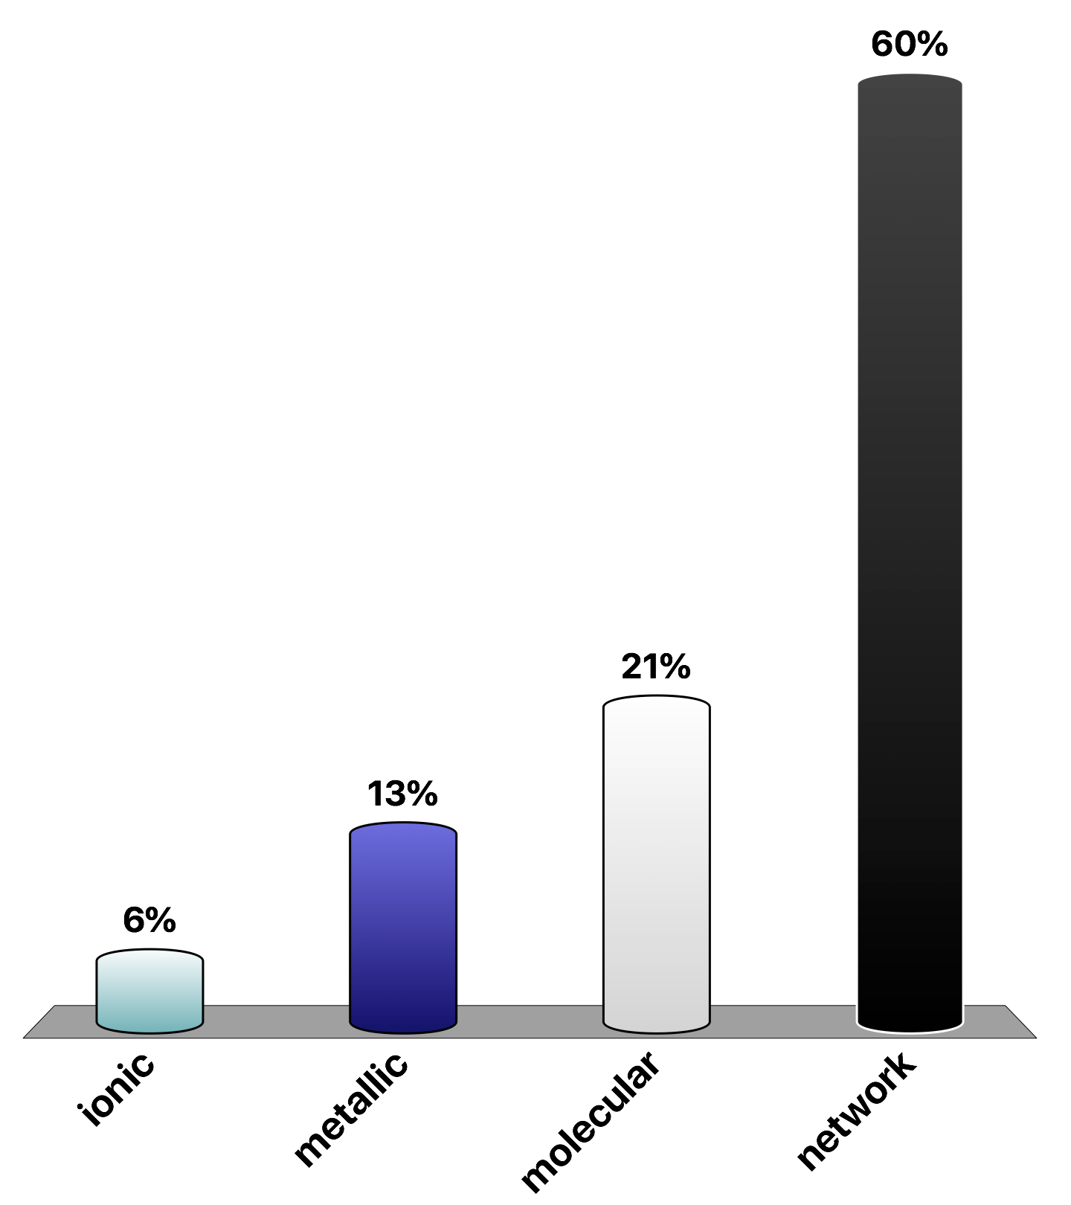
What type of solid is silicon carbide, SiC?
Practice: Solid-State Chemistry
Both Si and C are non-metals…likely connected via covalent bonds
ionic
metallic
molecular
network

Slide 27
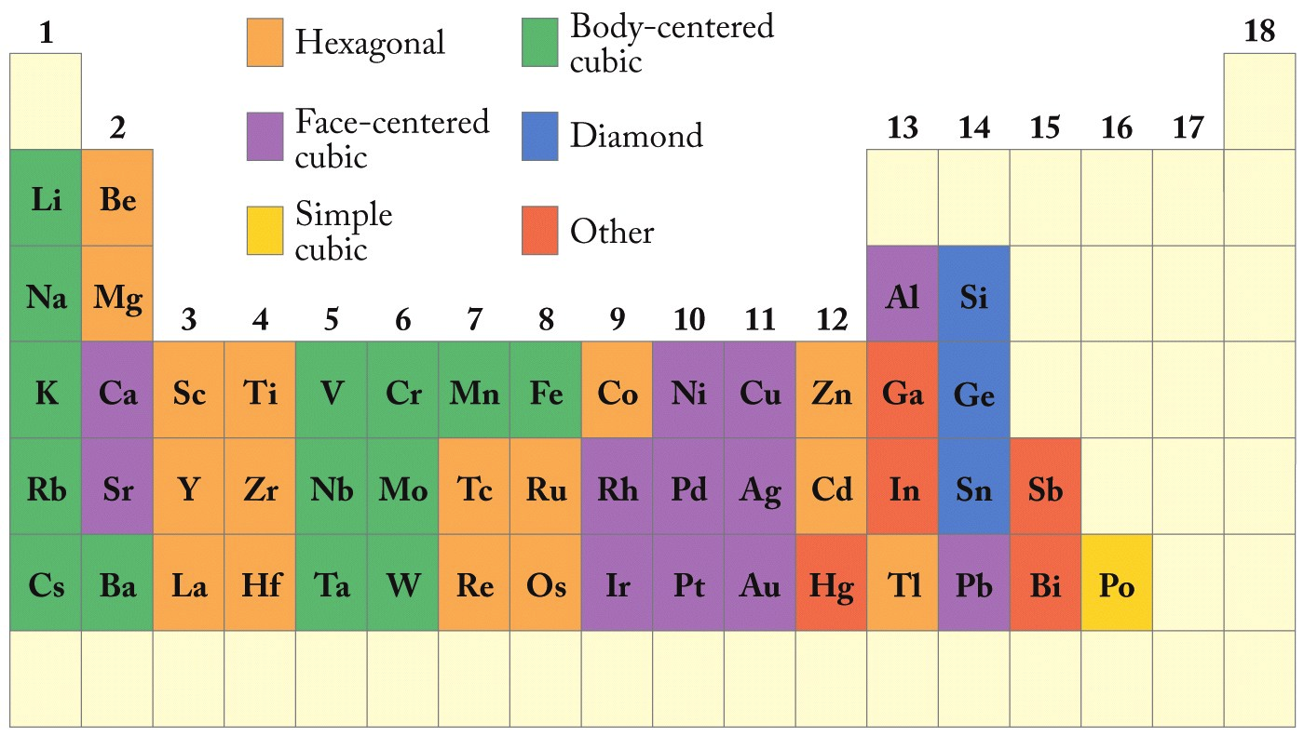
Crystal Structures of Metals

Slide 28
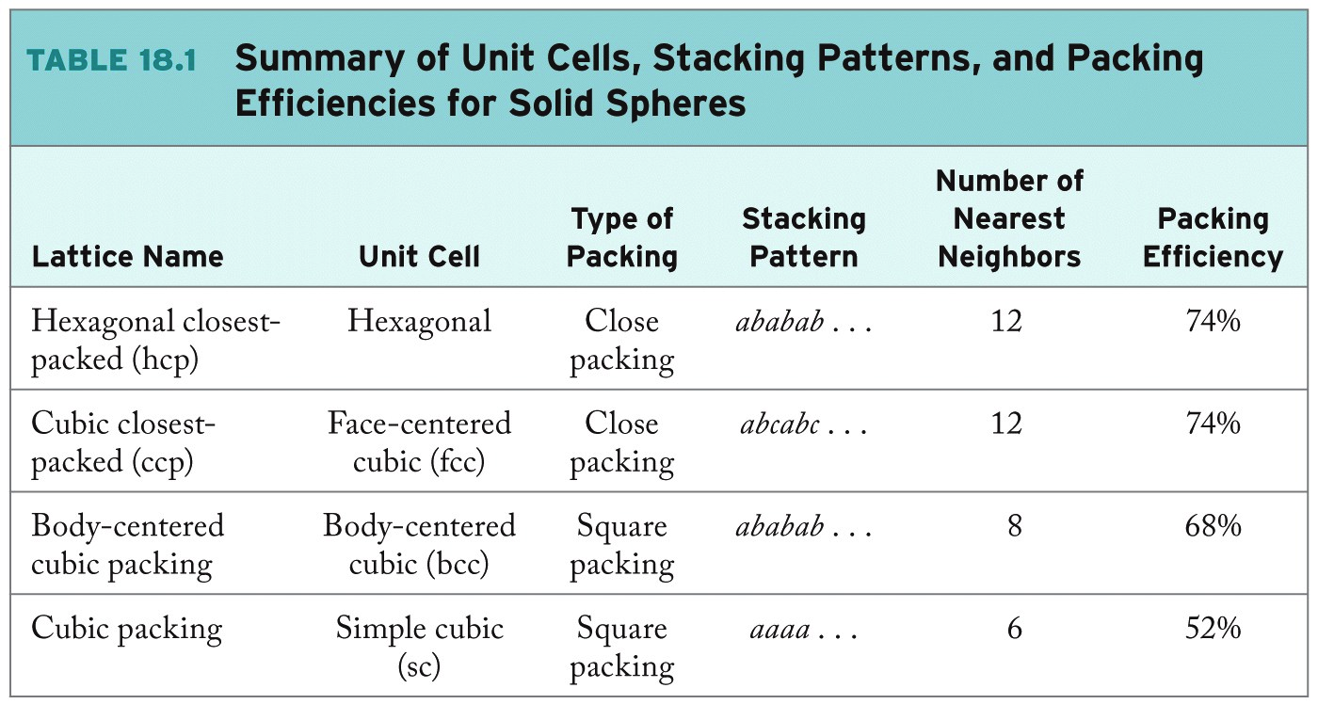
Summary
hcp and ccp: most efficient!

Slide 29
Structure of Functional Materials
Ores: naturally occurring compounds or mixtures of compounds from which elements can be extracted
Ionic solids: a solid consisting of monatomic or polyatomic ions held together by ionic bonds
Ceramic: a solid inorganic compound or mixture that has been transformed into a harder, more heat-resistant material by heating
Alloy: a blend of a host metal and one of more other elements, which may or may not be metals, that are added to change the properties of the host metal
Generally makes the metals harder, stronger, more durable
Examples: bronze, brass, etc.
Notes:
Metals have been used for tools, weapons, currency, and jewelry for thousands of years. Initially only three elements (copper, silver, and gold) were used because they are the only ones found free in nature. Most silver and copper are found as ores, argentite (Ag₂S) chalcopyrite (CuFeS₂), and chalcocite (Cu₂S). Ores are naturally occurring compounds or mixtures of compounds from which elements can be extracted. Most ores are ionic solids consisting of monatomic or polyatomic ions held together by ionic bonds. Ceramics are solid inorganic compounds or mixtures of compounds that have been heated in such a way to transform them into a harder and more heat-resistant material.
Most gold jewelry is not pure gold as it is one of the softer metals and is very easy to bend. Gold blended with other metals (palladium, silver, or copper) is more resistant to physical damage. Any mixture of a host metal with one or more other elements is called an alloy. Some alloys are solid solutions, homogeneous at the atomic level and others are heterogeneous mixtures. The properties of alloys can be modified by varying the proportions of metals present.
One of the first alloys, bronze, a mixture of copper and tin, was used to make tools and weapons that were harder, stronger, and more durable than those of copper alone. Brass is another copper alloy mixed with zinc. This alloy does tarnish over time but it is popular in hospitals for its antimicrobial properties (due to copper).
Aluminum alloys are ideal for making aircraft because they are strong and lightweight. New alloys find use in sports such as a patented five-metal alloy of nickel, zirconium, titanium, copper, and beryllium for making golf clubs.
We will look at the links between the physical properties of solids at the macroscopic level and the structures of these solids at the atomic level.

Slide 30
Bonding Models for Metals
A successful bonding model for metals must consider:
Malleability
Ductility
Efficient uniform conduction of heat and electricity
Bonding models for metals include:
Electron sea model
Band model (MO model)
Notes:
(9.4) Structure and bonding in metals

Slide 31
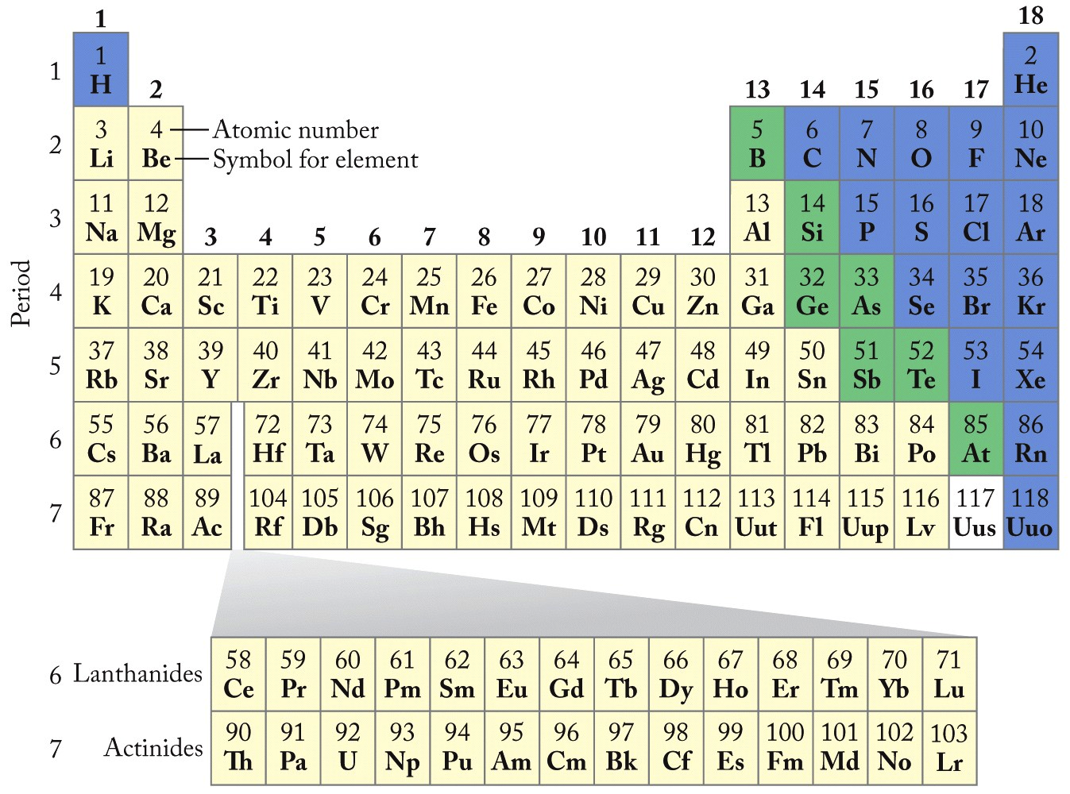
Metals: Conductors

Slide 32
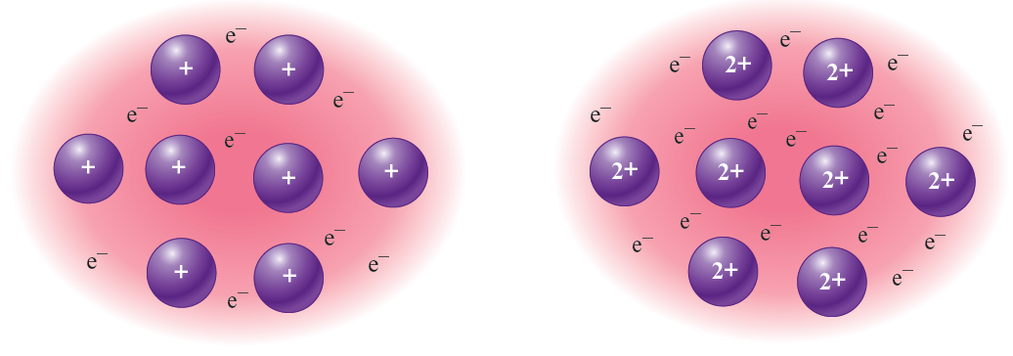
Bonding Models for Metals
Electron sea model
A regular array of metal cations are considered to be in a sea of mobile valence electrons
Mobile electrons conduct heat and electricity
Ions can freely move around when the metal is hammered or drawn into a wire
Notes:
(9.4) Structure and bonding in metals

Slide 33
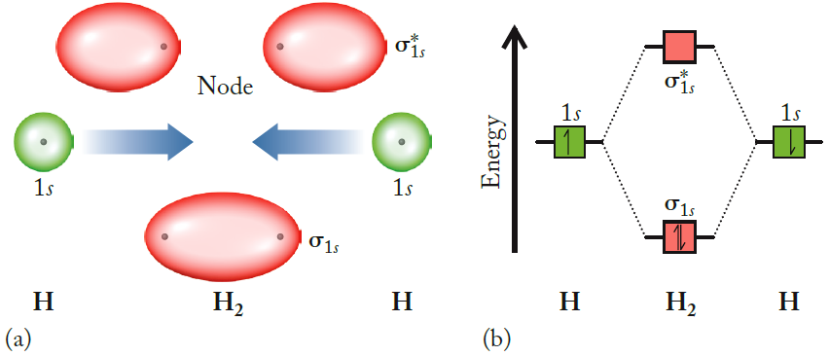
Bonding Models for Metals
Band theory, or the molecular orbital (MO) theory
Electrons are assumed to be traveling in molecular orbitals formed from the valence atomic orbitals of the metal atom
Interaction between metal atoms results in a virtual continuum of levels, called bands
anti-bonding
Two 1s orbitals mix to yield two sigma MOs
(1 bonding, 1 antibonding).
bonding
Notes:
(9.4) Structure and bonding in metals

Slide 34
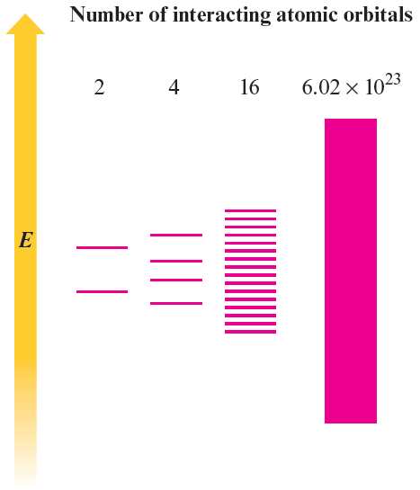
Molecular Orbital Energy Levels Produced When Various Numbers of Atomic Orbitals Interact
Bonding Models for Metals
Notes:
(9.4) Structure and bonding in metals

Slide 35
Bonding Models for Metals
Band Theory:
An extension of molecular orbital theory that describes bonding in solids
Valence Band:
A band of orbitals filled or partially filled by valence electrons
Conduction Band:
In metals, an unoccupied band higher in energy than a valence band, in which electrons are free to migrate
Conductor:
A material with partially filled valence bands or filled valence bands that overlap with empty conduction bands, leading to highly mobile electrons

Slide 36
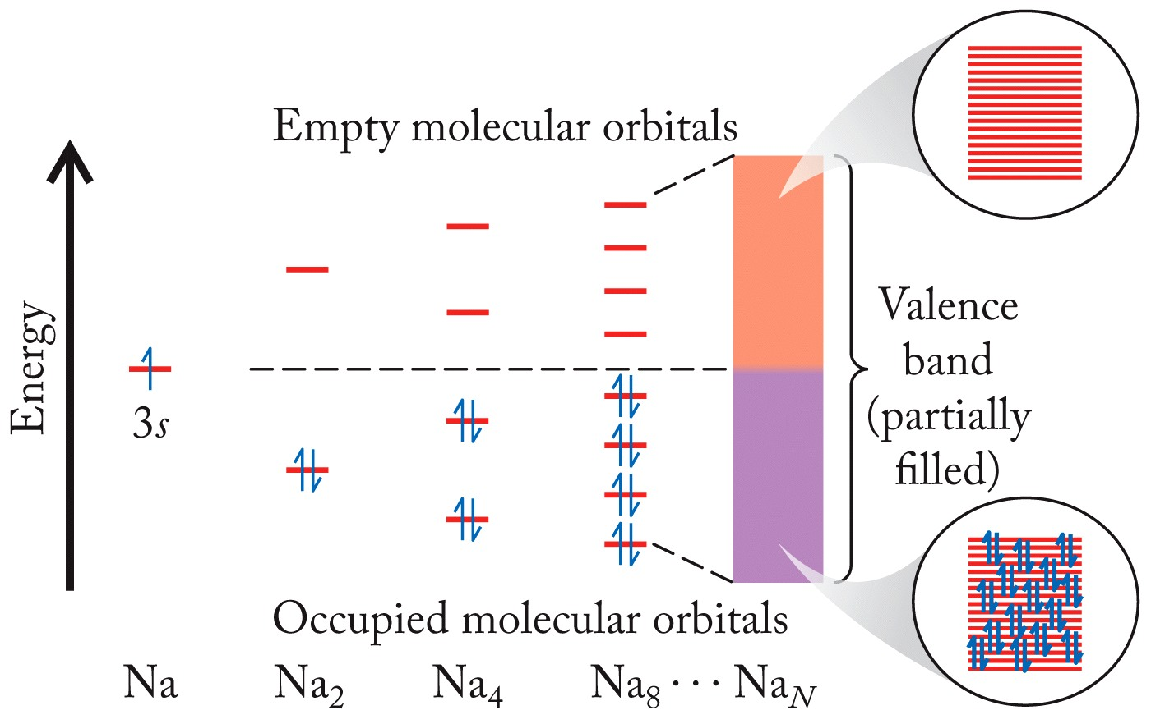
Band Theory
Easily accessible higher energy levels
The more metal “bonds” formed the closer and closer the molecular orbitals get!

Slide 37
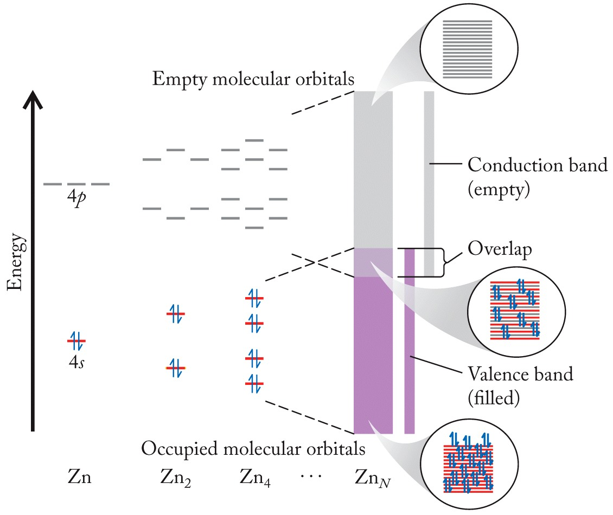
Band Theory
Different perspective…
LUMO (Lowest unoccupied molecular orbital)
HOMO (Highest occupied molecular orbital)

Slide 38
Metalloids: Semiconductors

Slide 39
Semiconductors
Band Gap (E_{g}): Energy gap between the valence and conduction bands
Electrons of certain elements can cross the energy gap at 25^{ₒ}C, making them a semiconducting element
Conductivity increases with increasing temperature
Semiconductor: A semimetal (metalloid) with electrical conductivity between that of metals and insulators that can be chemically altered to increase its electrical conductivity
n-type semiconductor: A semimetal containing electron-rich dopant atoms
p-type semiconductor: A semimetal containing electron-poor dopant atoms

Slide 40
Update Wed 4/15/20
Summary/notes
Unit Cells
Simple Cubic (sc)
Hexagonal
Face-Centered Cubic (fcc)
Body-centered cubic (bcc)
Many others we’re not covering
Networks like Diamond and SiO₂
Office hours today 2-3
Friday Exam Revies
Exam Monday 8:00 – 11:30 pm
Best to take it during the day to get help if necessary.

Slide 41
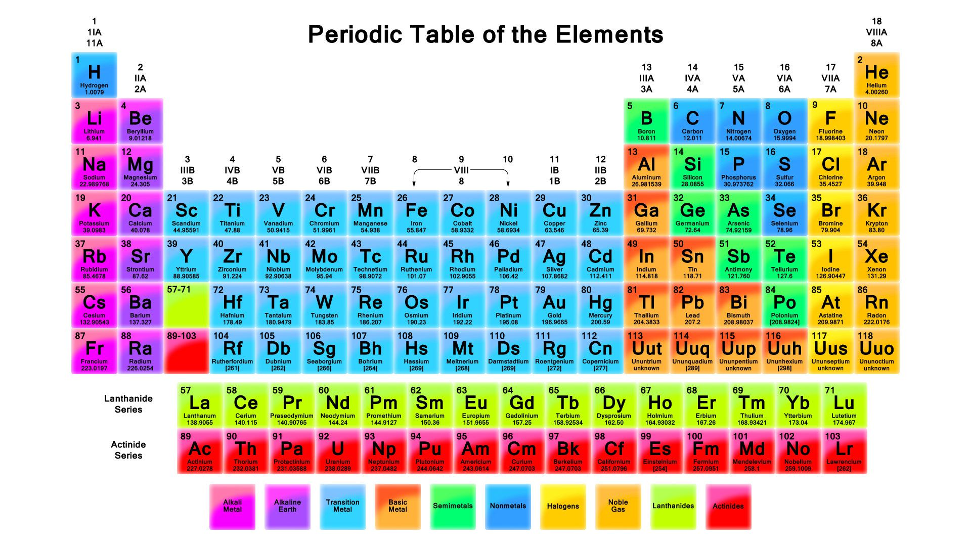
Silicone (group 4) doped with either group 3 or 5.
“The new Si” Ga N Group 3/ Group 5 in equal amounts averages to 4 valence electrons.
Add Group 3 like B or In has one less valance electron = hole (+) = p-type.
Our Blue and Green: In_{x}Ga_{1-x}N
Add Group 5 like Sb has extra valence electron (-) n-type
Red, Orange, Yellow: InP is a 3/5 combination (Al_{x}Ga_{1-x})_{y}In_{1-y}P typically y = 0.5
(Al_{x}Ga_{1-x})_{0,5}In_{0.5}P and x is adjusted to change color.

Slide 42
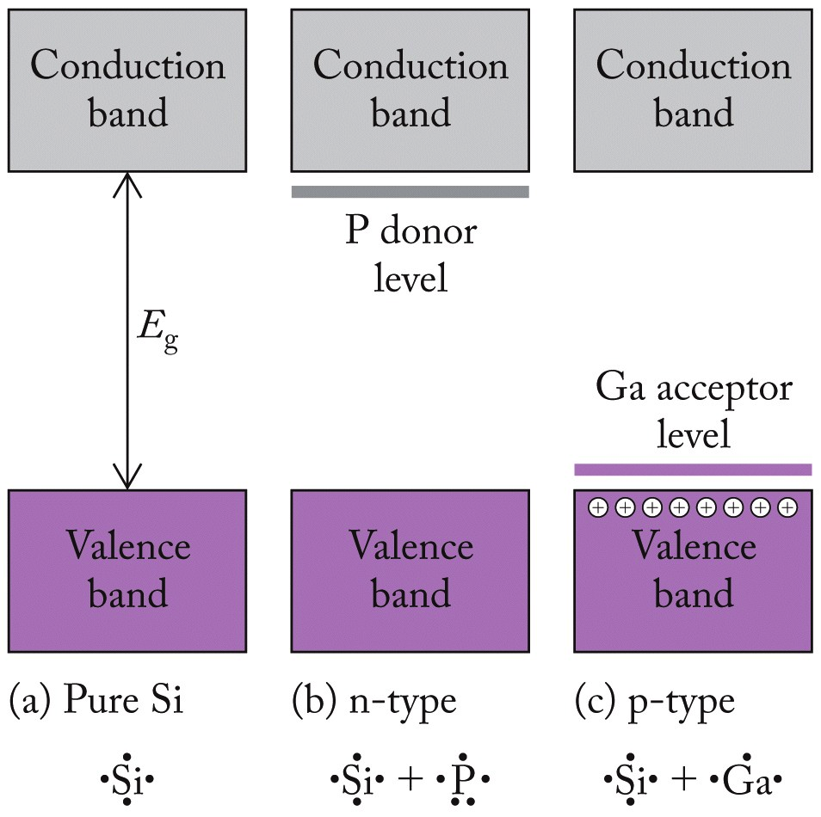
Semiconductors
Adding electrons, lowers conduction band
Adding a dopant helps adjust the band gap and tailor electronic or optoelectronic properties
Removing electrons, raises valence band

Slide 43
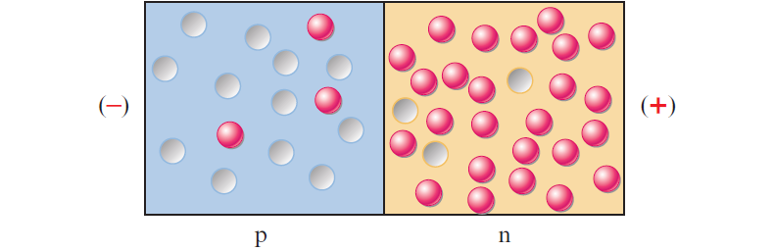
Semiconductors
The connection of a p-type and an n-type form a p–n junction where:
Small number of electrons migrate from n-type area to p-type area where low-energy MOs are vacant
Net effect of this migration is to place negative charge on the p-type region and positive charge on the n-type region
This build-up, the contact or junction potential, prevents further migration
Notes:
(9.5) Carbon and silicon: Network atomic solids

Slide 44
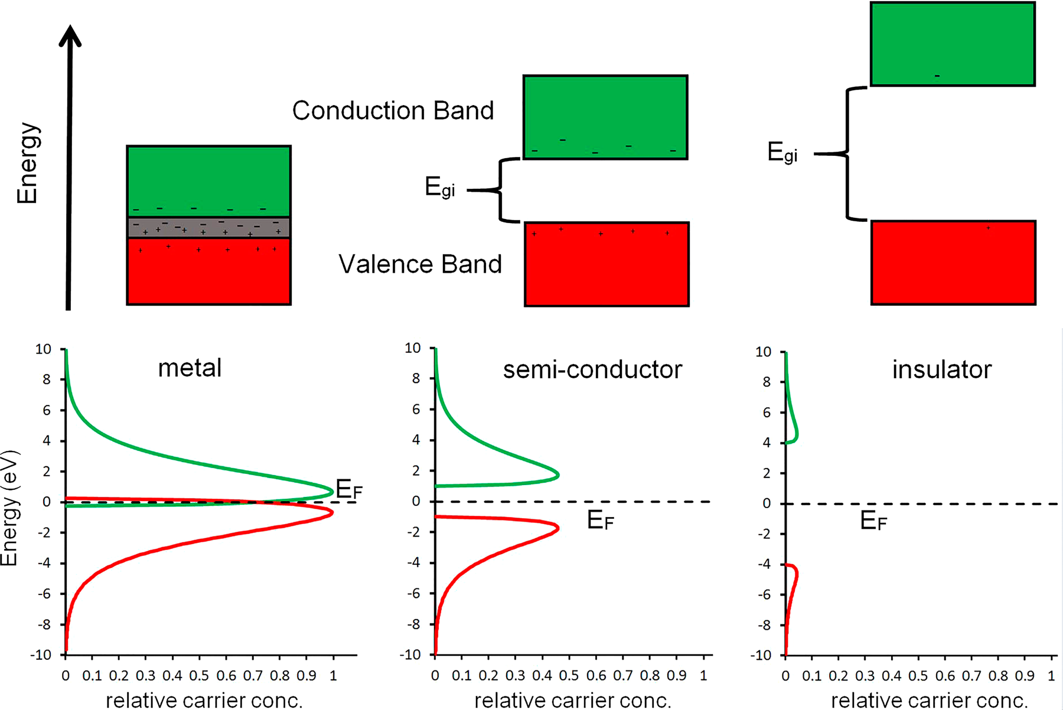
Metal to insulator
n-type extra electrons in conduction band.
p-type holes in valance band.
Notes:
Wagner Figure 2. (Top) Relative comparison of band diagrams for an insulator, a semiconductor, and a metal. The intrinsic bandgap energy, Egi, is the
separation between the top of the valence band and the bottom of the conduction band. In metal systems, there is no effective bandgap and
oftentimes the valence and conduction band overlap (gray area). (Bottom) Relative comparison of carrier concentration profile. As the energy gap
increases, the number of electrons promoted from the valence to conduction band decreases significantly. As a result, conductivity of the material
decreases. The carrier concentration profile is determined by the density of states (spacing of the energy levels in the band) and Boltzmann’s
distribution. The charge carriers in the bands are represented by the plus and minus symbols. The Fermi level (EF) is represented by the dashed line.

Slide 45
The molecular orbital description for metal bonding is different from that for diatomic molecules in that ________
Practice: Band Theory
there are no antibonding orbitals in the metal bonding description.
quantum theory no longer applies, as the orbitals are continuous.
the orbitals are so close in energy that they are referred to as bands.
the increased number of electrons results in each bond being stronger.
All of the above are true.

Slide 46
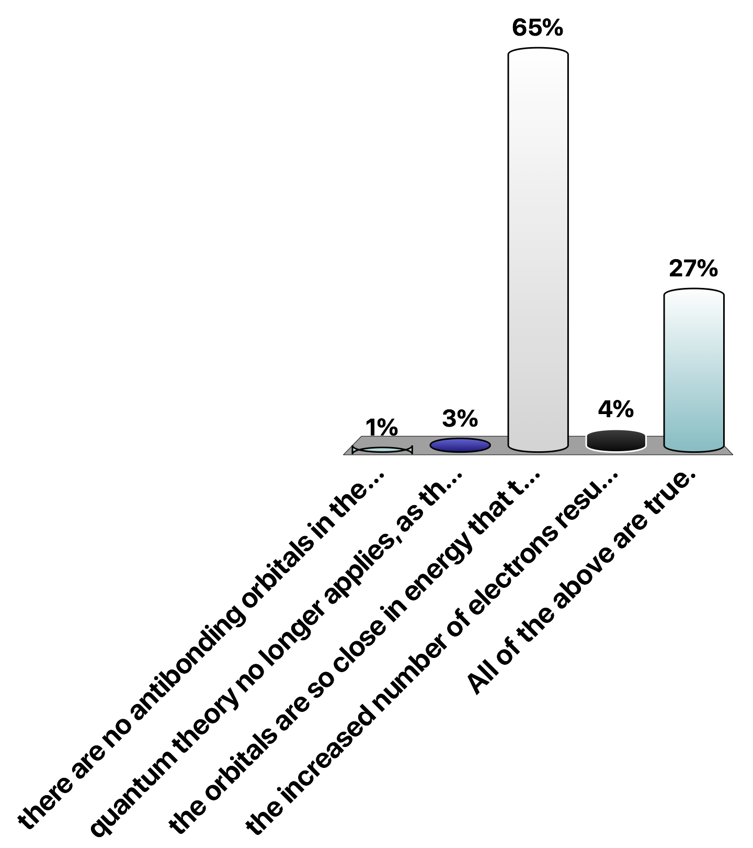
The molecular orbital description for metal bonding is different from that for diatomic molecules in that ________
Practice: Band Theory
there are no antibonding orbitals in the metal bonding description.
quantum theory no longer applies, as the orbitals are continuous.
the orbitals are so close in energy that they are referred to as bands.
the increased number of electrons results in each bond being stronger.
All of the above are true.

Slide 47
Metal solids are good conductors of electricity because ________
Practice: Band Theory
they are easily ionized.
their valence electrons are not localized.
they are easily reduced and oxidized.
they can be drawn into wires.
they are ductile.

Slide 48
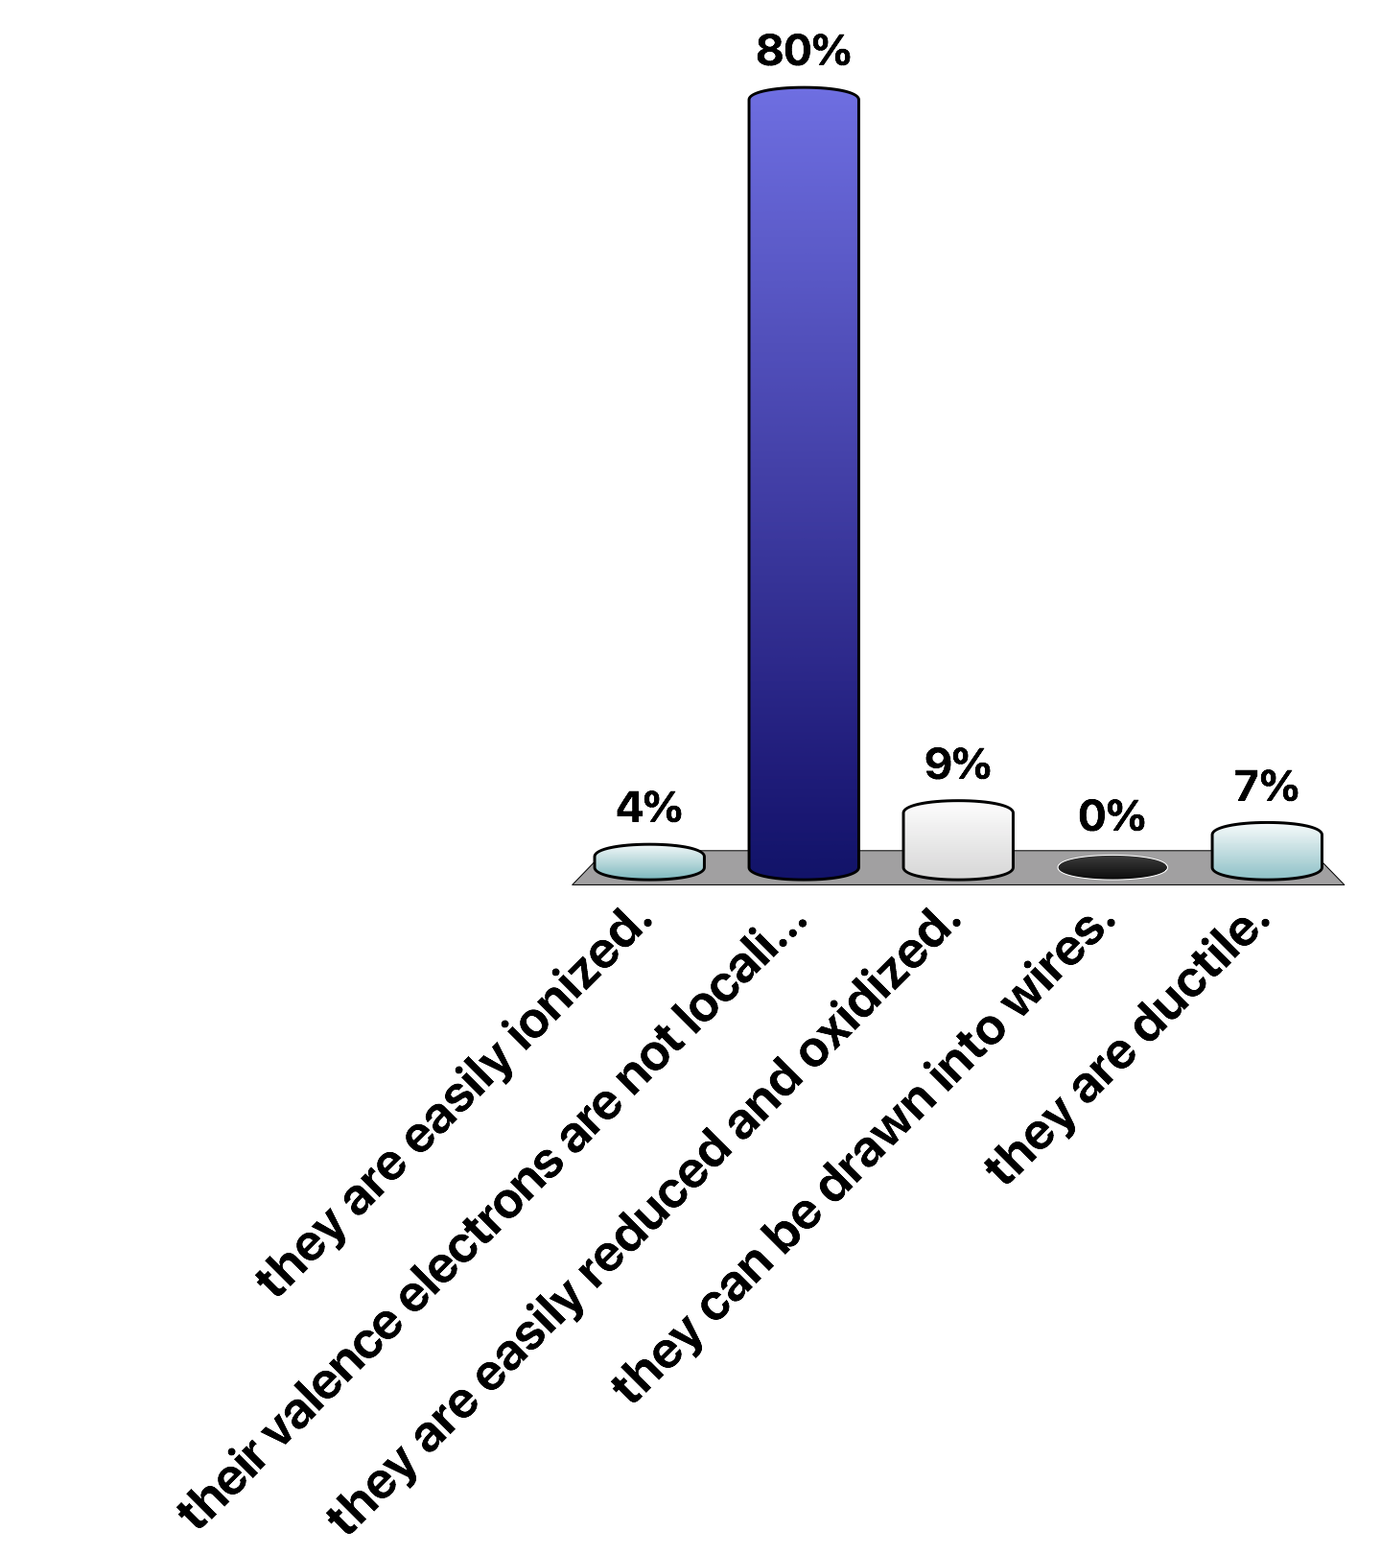
Metal solids are good conductors of electricity because ________
Practice: Band Theory
they are easily ionized.
their valence electrons are not localized.
they are easily reduced and oxidized.
they can be drawn into wires.
they are ductile.

Slide 49
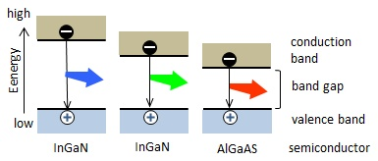
Bandgap E_{g} in LEDs
Semiconductors have small E_{g}
0.10 eV to 3.5 eV
E_{g} determined by ratio of III-V dopants
All kinds of combinations!
In_{x}Ga_{1-x}N
(Al_{x}Ga_{1-x})_{y}In_{1-y}P
Blue has a large bandgap
Stable blue LEDs are difficult
Simard-Normandin, LED Technology Journal, 2013
Image from: https://www.fiberlabs-inc.com/about-led/

Slide 50
Practice: Band Gaps
When a small amount of silver is added to zinc sulfide as an activator, the band gap of the resulting material is approximately 266 kJ/mol. If it were used as a light-emitting diode, what color of light would be emitted?
Where:
h = Planck’s constant = 6.626 × 10⁻³⁴ J∙s
v = frequency in Hz (s⁻¹)
E = energy per photon
Energy of Light
Relationship between frequency and wavelength
Where:
c = speed of light = 3 × 10⁸ m/s
λ = wavelength in meters (m)
Relationship between energy and wavelength
Can use this relationship to calculate wavelength, determine what color of light!

Slide 51
Practice: Band Gaps
When a small amount of silver is added to zinc sulfide as an activator, the band gap of the resulting material is approximately 266 kJ/mol. If it were used as a light-emitting diode, what color of light would be emitted?
Relationship between energy and wavelength:
blue
Rearrange:

Slide 52
Practice: Band Gaps
Gallium arsenide (GaAs) is a semiconductor with a band gap of approximately 137 kJ/mol. The band gap of gallium nitride (GaN) is about 2.39 times greater than that of GaAs. What wavelength of light does each material emit when electrons in the conduction band fall back into the valence band? Express your answers in nanometers.
GaAs
Relationship between energy and wavelength:
Rearrange:

Slide 53
Practice: Band Gaps
Gallium arsenide (GaAs) is a semiconductor with a band gap of approximately 137 kJ/mol. The band gap of gallium nitride (GaN) is about 2.39 times greater than that of GaAs. What wavelength of light does each material emit when electrons in the conduction band fall back into the valence band? Express your answers in nanometers.
GaN
Relationship between energy and wavelength:
Rearrange:

Slide 54
Crystalline Solids of Nonmetals
Covalent Network Solids:
Rigid, three-dimensional array of covalently bonded atoms
Molecular Solids:
Neutral, covalently bonded molecules held together by intermolecular attractive forces
Clusters:
Ordered collections of atoms that are larger than typical molecular solids, smaller than network covalent solids

Slide 55
Covalent Network Solids
Network solids are those atomic solids that contain directional covalent bonds which form solids that can be viewed as “giant molecules”
Properties:
Brittle nature
Ineffective conductors of heat and electricity
Important elements:
Carbon
Silicon
Allotropes: different molecular structures of an element
Diamond and graphite
Notes:
(9.5) Carbon and silicon: Network atomic solids

Slide 56
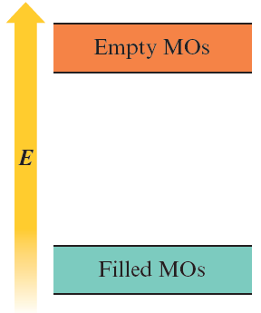
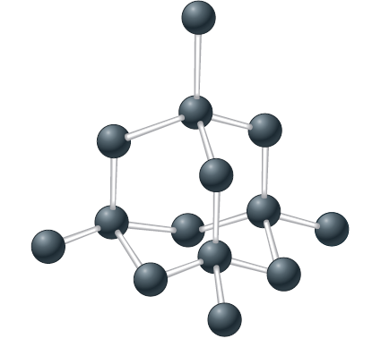
Covalent Network Solids: Diamond
Hardest naturally occurring substance
Each C atom is surrounded by a tetrahedral arrangement of other C atoms
Structure as per the molecular orbital theory:
Diamond
tetrahedral carbons
Large gaps between filled and empty level and electron transfer is not easy
Notes:
(9.5) Carbon and silicon: Network atomic solids

Slide 57
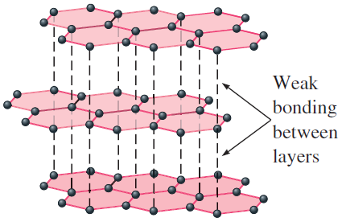
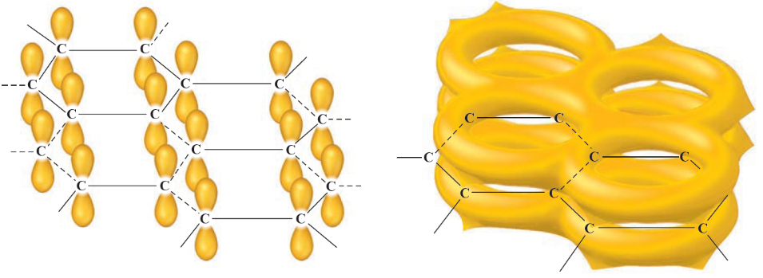
Covalent Network Solids: Graphite
Slippery, black, and a conductor of heat and electricity
Structure is based on layers of C atoms arranged in fused six-membered rings
Shows trigonal planar arrangement with 120-degree bond angles and sp² hybridization
Structure as per the MO theory:
All orbitals combine to form π MOs
Assist in the stability of graphite
Delocalized electrons account for good electrical conductivity
By applying 150,000 atm pressure at 2800^{ₒ}C, graphite can be converted to a diamond
Graphite
MO picture
Notes:
(9.5) Carbon and silicon: Network atomic solids

Slide 58
Molecular Solids
Possess strong covalent bonding within molecules but weak forces between molecules
Forces among the molecules depend on the nature of the molecules
CO₂, I₂, P₄, and S₈ - no dipole moment; possess London dispersion forces
Molecules that possess dipole moments have greater intermolecular forces, especially when hydrogen bonding is viable
Notes:
(9.6) Molecular solids

Slide 59
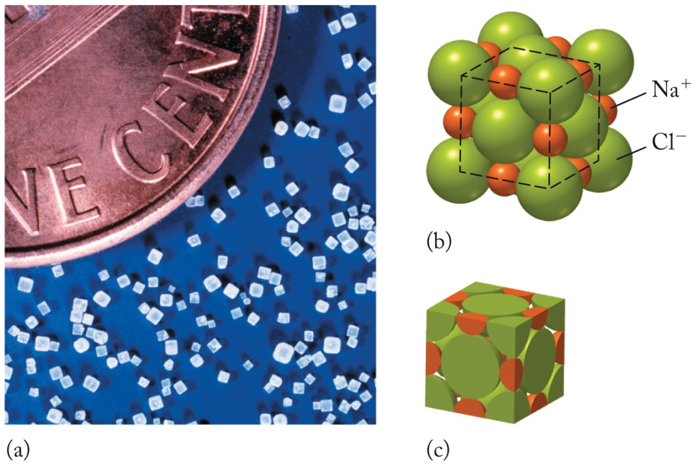
Ionic Solids: Salt Crystals
Ionic solids
Consist of monoatomic or polyatomic ions held together by ionic bonds
Binary salts
Ex. NaCl
Cubic shape
Face-centered cubic
Cl⁻ at corners
Na⁺ in octahedral holes
Rock salt structure
Notes:
Most of Earth’s crust is made of ionic solids consisting of monatomic or polyatomic ions held together by ionic bonds. Most of these solids are crystalline. The simple crystal structures are those of binary salts such as NaCl. The cubic shape of large NaCl crystals is a reflection of the cubic shape of the NaCl unit cell.
The unit cell of NaCl is a face-centered cubic arrangement of Cl⁻ ions at the corners and in the center of each face with the smaller Na⁺ ions occupying the 12 octahedral holes along the edges of the unit cell and at the single octahedral hole in the middle of the cell.
Like metal atoms in the fcc cell, an isolated unit cell contains portions of 14 Cl⁻ ion: one at each corner and one in each of the six faces of the cube for a total of four Cl⁻ ions in the unit cell. To count the Na⁺ ions note that one Na⁺ ion fits into each of the 12 octahedral holes along the edges of the cell. Because each Na⁺ ion along an edge is shared by four unit cells, only one-fourth of each Na⁺ ion on an edge is in each cell for a total of three Na⁺ ions. The fourth Na⁺ ion is in an octahedral hole in the middle of the unit cell.
Adjacent Cl⁻ ions along any face diagonal do not touch each other the way adjacent face-diagonal metal atoms do because the Cl⁻ ions have to spread out a little to accommodate the Na⁺ ions in the octahedral holes. Sodium and chloride ions touch along each edge of the unit cell. Each Na⁺ ion touches six Cl⁻ ions and each Cl⁻ ion touches six Na⁺ ions. This arrangement is common among binary ionic solids and called the rock salt structure.
Figure 18.34

Slide 60
Ionic Solids: Salt Crystals
Stable with high-melting points
Held together by strong electrostatic forces between oppositely charged ions
Structure is based on closest packing of spheres so that:
Electrostatic attraction between oppositely charged ions is maximized
Repulsion among ions with like charges is minimized
Notes:
(9.7) Ionic solids

